Slide 1

Internship project:
Test automation
Mentor: Igor Banjac Demo II
Intern: Amina Alijagić

Slide 2

Agenda
Demo 2 tasks
Regression test for Navigator.ba
abhShoes
Smoke and regression tests for abhShoes
Challenges
Questions

Slide 3
Demo 2 tasks
Create automation test script for regression test for Navigator.ba
abhShoes - exploratory testing
Create test cases for abhShoes
Based on exploratory testing write smoke test for abhShoes
Write regression tests for abhShoes
Create automation test script for smoke test for abhShoes
Create automation test script for regression test for abhShoes
Write full bugs/improvements report
Push project to a GitHub repository
Get familiar with Jenkins

Slide 4

Test automation tools
Ruby as a script language
Rspec - DSL language for Ruby
Selenium
Capybara
OS | Linux Ubuntu 16.04
Version control | Git Repository
Project management | Trello board

Slide 5


Regression test for Navigator.ba

Slide 6
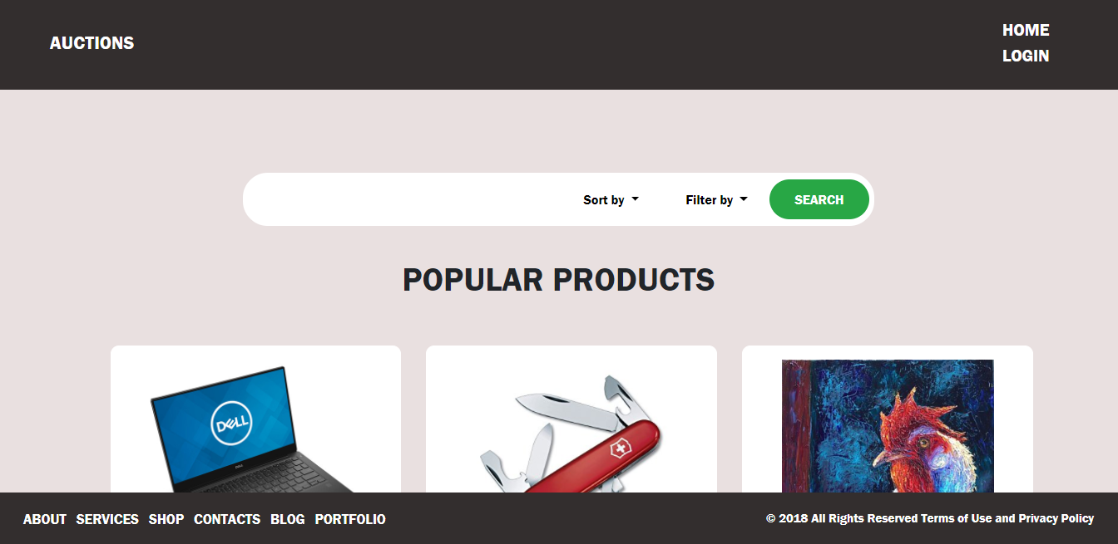
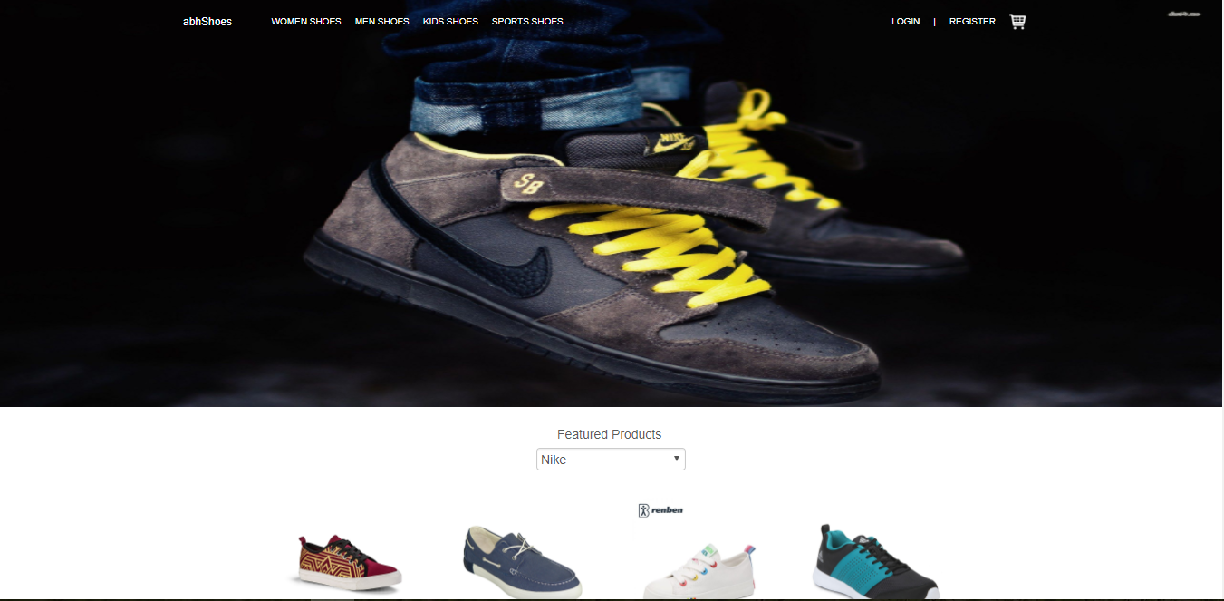
AuctionApp vs. abhShoes

Slide 7
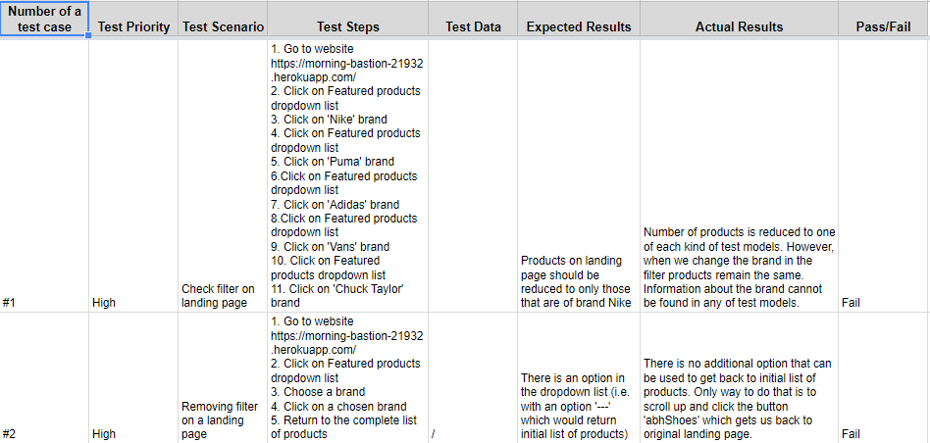
Test cases
44 test cases, 19 are fails or improvements, 1 was critical bug. Note: Admin panel cases are not included yet.

Slide 8
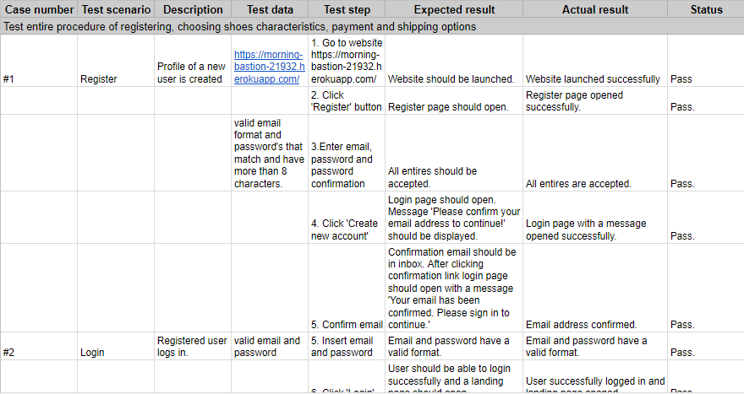
Smoke and Regression test

Slide 9
Test scripts for Smoke and Regression tests

Slide 10
Bugs and Improvements Report

Slide 11

Challenges
Setting up environment
Changing application
Stripe window automation
Gmail confirmation link for registration

Slide 12

Questions?

